Slide 1


 |  |  | Obchodní akademie a Střední odborná škola, gen. F. Fajtla, Louny, p.o. Osvoboditelů 380, Louny
Číslo projektu | CZ.1.07/1.5.00/34.0644 | Číslo sady |  | 32 |  | Číslo DUM | 05
Předmět | Anglický jazyk
Tematický okruh | Cizojazyčné reálie
Název materiálu | Football in UK, USA and Australia
Autor | Mgr. Iris Kernerová
Datum tvorby | Září 2013 | Ročník |  |  | třetí
Anotace Porovnání různých forem hry fotbal ve Velké Británii, Spojených státech amerických a Austrálii, jejich historický vývoj ve formě prezentace.
Metodický pokyn 1) Před spuštěním prezentace vyzvěte studenty, aby sdělili, jaké druhy fotbalu znají a kde se hrají. 2) Spusťte prezentaci a nechte žáky odpovídat na jednotlivé otázky uvedené ve snímcích. 3) Vysvětlete historický vývoj této hry a jejích místních forem. 4) Nechte žáky vyplnit tabulku shrnující fakta o této hře. 5) Porovnejte jejich výsledky s informacemi z prezentace.

Slide 2
Let‘s play football!

Slide 3
What game would you play in Great Britain, the USA or Australia if a friend of yours asks you?

Slide 4
FOOTBALL! But…

Slide 5
Name of the game in
GB :
the USA :
Australia :
Association football
American football
Australian football

Slide 6
Nicknames
Association football
American football
Australian football
Footy Gridiron Soccer

Slide 7
Nicknames
Association football Soccer
American football
Australian football
Footy Gridiron

Slide 8
Nicknames
Association football Soccer
American football Gridiron
Australian football
Footy

Slide 9
Nicknames
Association football Soccer
American football Gridiron
Australian football Footy

Slide 10
Where would you play it?

Slide 11
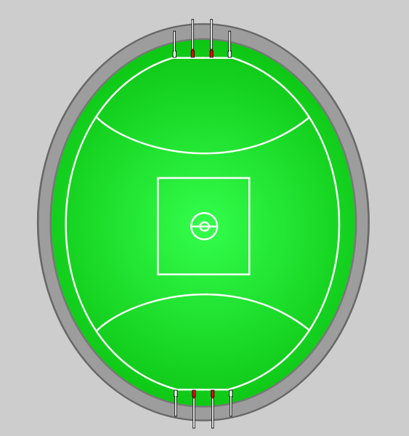
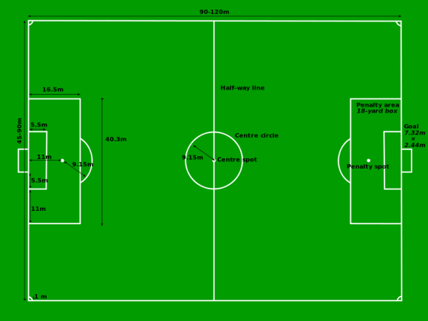
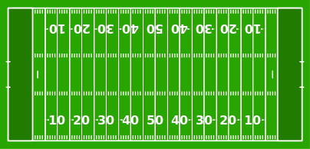
Field
Australian football
American football
Association football
Obr. 1
Obr. 3
Obr. 2

Slide 12
What would you play it with?

Slide 13
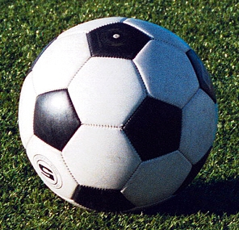

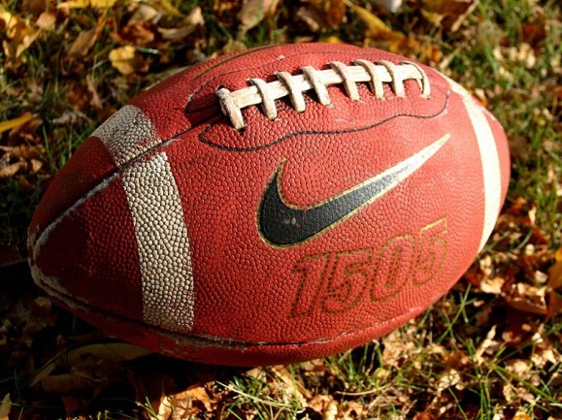
Ball
Australian football
Association football
American football
Obr. 4
Obr. 6
Obr. 5

Slide 14
How would I get dressed?

Slide 15
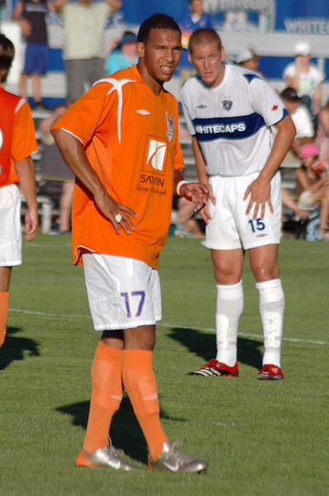
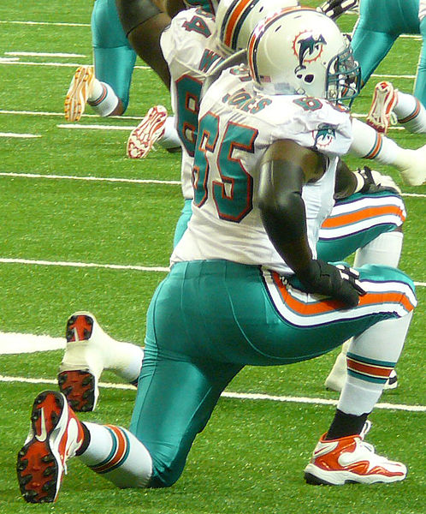
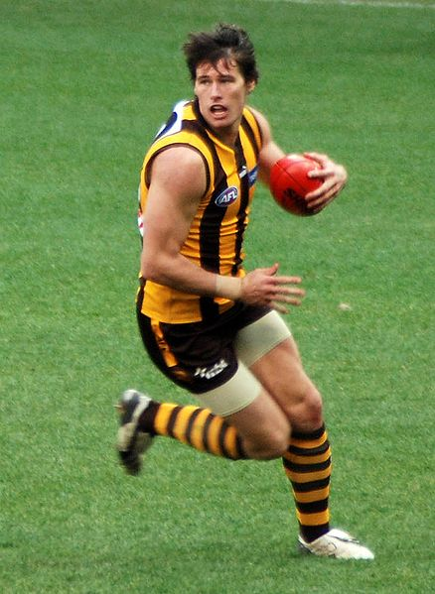
Player
Association football
American football
Australian football
Obr. 7
Obr. 8
Obr. 9

Slide 16
How many players are there in one team?

Slide 17
Number of players
Association football
American football
Australian football
11 18 11

Slide 18
Number of players
Association football 11
American football 11
Australian football 18

Slide 19
How long would I play?

Slide 20
Length of the game
Association football
American football
Australian football
2x45 4x15 4x20

Slide 21
Length of the game
Association football 2x45
American football 4x15
Australian football 4x20

Slide 22
So what is behind all of this? Why did it happen?

Slide 23
Why?
Hands or feet?
Rugby goes to America
Cricket players keep fit

Slide 24
Association football
Hands or feet?
In public schools in England football was played in varied forms (various rules, size of the field, numbers of players).
In 19th century two forms of football were formed:
association football and rugby

Slide 25
American football
Rugby goes to America
In the 19th century rugby was popular in American universities with varied rules . So the met and agreed to new rules and set
American football.

Slide 26
Australian football
Cricket players keep fit
In the 19th century sport Nr. 1 in Australia was cricket. However, it was played only in summer. So how to keep fit the players during winter?
Let them play rugby on their cricket field!

Slide 27
What do you remember?
 | Association football | American football | Australian football
Nickname
Number of players
Length of the game
Draw the picture of the field
Draw the shape of the ball

Slide 28
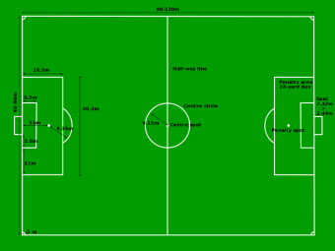
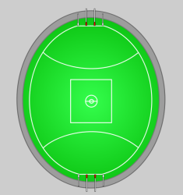
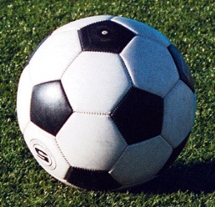

What do you remember?
 | Association football | American football | Australian football
Nickname | Soccer | Gridiron | Footy
Number of players | 11 | 11 | 18
Length of the game | 2 x 45 | 4 x 15 | 4 x 20
Draw the picture of the field
Draw the shape of the ball
Obr.1
Obr.3
Obr.2
Obr.5
Obr.6
Obr.4

Slide 29
Použité zdroje
Wikipedia the free encyclopedia. NIELS, F . Wikipedia.org: File:Football pitch metric.svg [online]. 13.05.2006. 2006, 5.07.2006 [cit. 2013-09-24]. Dostupné z: http://en.wikipedia.org/wiki/File:Football_pitch_metric.svg
Wikipedia otevřená encyklopedie. RAZORBLISS. Wikipedia.org: Soubor:AmFBfield.svg [online]. 29.07.2006. 2006, 4.03.2012 [cit. 2013-09-24]. Dostupné z: http://cs.wikipedia.org/wiki/Soubor:AmFBfield.svg
Wikipedia the free encyclopedia. CFLM001. Wikipedia.org: File:AFL stadium.svg [online]. 27.08.2009. 2009, 27.08.2009 [cit. 2013-09-24]. Dostupné z: http://en.wikipedia.org/wiki/File:AFL_stadium.svg
Wikipedia commons. MOONDYNE. Wikipedia.org: File:Sherrin.png [online]. 29.10.2008. 2008 [cit. 2013-09-24]. Dostupné z: http://commons.wikimedia.org/wiki/File:Sherrin.png
Wikipedia the free encyclopedia. BRUNO, Christopher. Wikipedia.org: File: Football Pallo valmiina-cropped.jpg [online]. 18.11.2009. 2009,[cit. 2013-09-24]. Dostupné z: http://en.wikipedia.org/wiki/File:Football_Pallo_valmiina-cropped.jpg
Wikipedia commons. DSW4. Wikipedia.org: File:Football on ground.jpg [online]. 17.10.2008. 2008 [cit. 2013-09-24]. Dostupné z: http://commons.wikimedia.org/wiki/File:Football_on_ground.jpg
Wikipedia commons. LONGBOMB. Wikipedia.org: File:Matt-watson-soccer-player.jpg [online]. 03.08.2008. 2008 [cit. 2013-09-24]. Dostupné z: http://commons.wikimedia.org/wiki/File:Matt-watson-soccer-player.jpg?uselang=cs
Wikipedia commons. BOTMULTICHILLT. Wikipedia.org: File: DJ Jones.jpg [online]. 29.08.2011. 2011, 8.1.2012 [cit. 2013-09-24]. Dostupné z: http://commons.wikimedia.org/wiki/File:DJ_Jones.jpg?uselang=cs
Wikipedia commons. SHAKATAGANAI. Wikipedia.org: File: Aussie rules football player copy.jpg [online]. 5.08.2008. 2008, 6.8.2008[cit. 2013-09-24]. Dostupné z: http://commons.wikimedia.org/wiki/File:Aussie_rules_football_player_copy.jpg?uselang=cs

